Slide 1
Ergonomic Strategies
Work doesn’t have to hurt
Kristi Evans Occupational Safety Professional

Slide 2
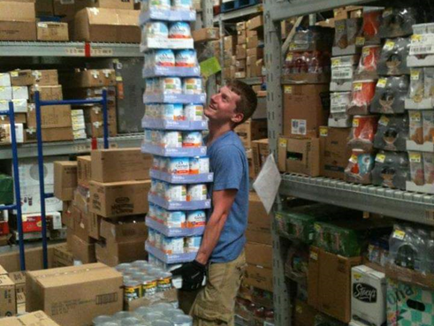
Cost of Workplace Injuries
80% lifetime prevalence
>$100 billion in health care
2/3 costs time loss and lost productivity
5-10% of the cases = 75-80% of the costs
Katz JBJS 2006

Slide 3
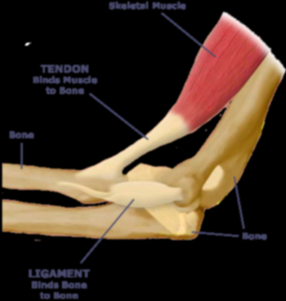
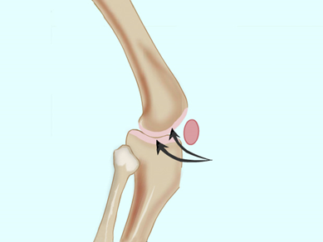
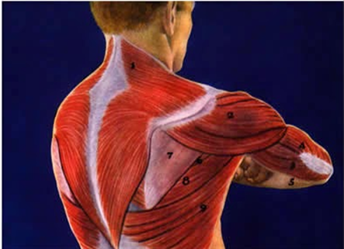
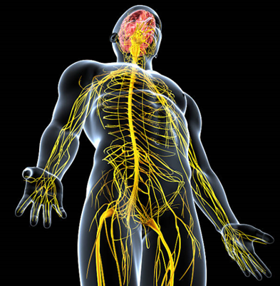
What Are Musculoskeletal
Injuries and illnesses that affect muscles, nerves, tendons, ligaments, joints or spinal discs

Slide 4
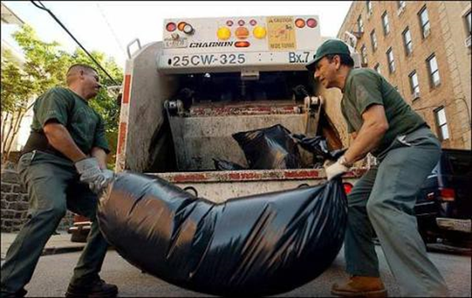
Musculoskeletal Disability and Work in the US
12% “working age” have a self-reported work-limiting Musculoskeletal Disability (MSD) condition (NHIS)
3.6% are temporarily out of work as a result
4 MSD’s related to work per 100 workers per year - 25% are disabling (BLS)
4 times that amount have decreased performance on the job
Dennerlein et al. Am J Ind Med 55(2): 107-116.

Slide 5
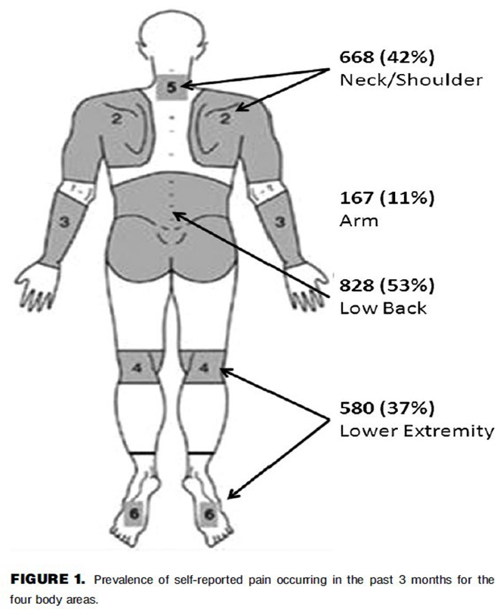
Wellbeing: Work Related MSDs
Most Frequently Reported at Purdue
Causes:
Lifting
Pushing
Pulling
Awkward Postures
Dennerlein et al. Am J Ind Med 55(2): 107-116.

Slide 6
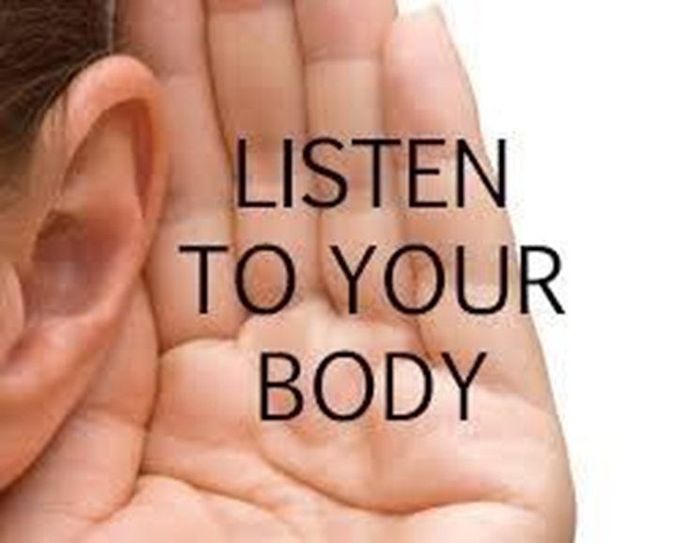
Listen To Your Body
Pain
Tingling
Numbness
Pain at night swelling
Decreased grip strength
Poor joint movement (stiffness)
Discoloration

Slide 7
Repetition
Making the same motions over and over places stress on the muscles, and tendons.
Severity of risk depends on frequency, speed, the number of muscles involved, and the required force.

Slide 8
Forceful Exertions
The amount of physical effort required to perform a task or to maintain control of equipment or tools.
Force is dependent on: type of grip, weight of object, body posture, type of activity and duration of task.

Slide 9
Awkward Postures
Position of the body and how it affects the muscle groups that are involved in physical activity.
Awkward postures include repeated or prolonged reaching, twisting, bending, kneeling, squatting, overhead work or holding fixed positions.

Slide 10
Contact Stress
Pressing the body against a hard or sharp edge can place too much pressure on nerves, tendons and blood vessels
For example, resting the arm against a corner while working can increase the likelihood of an MSD.

Slide 11

Risk Factors- Personal
Age
Gender
BMI
Physical Health
Mental health
Smoking
Genetics
National Research Council/Institute of Medicine committee (2001) National Academy Press

Slide 12
Risk Factors-Personal
Impaired Attention and Reaction Time
Risk of Injuries, Falls
Insufficient or Disordered Sleep
Decreased Memory
and Concentration
Incidence of Pain
Worse Mood; depression
Weight Gain
Impaired Task Completion
Diabetes
Psychosocial difficulties
Increased
Cardiovascular
Consumption of Healthcare Resources
Disease
Ancoli-Israel S, Cooke JR. J Am Geriatr Soc. 2005;53(suppl):S264-S271.
Choi SW et al. Am J Emerg Med. 2006 Mar;24(2):189-96. Spiegel K et al J Appl Physiol. 2005 Nov;99(5):2008-19.
Buxton OM et al., Effects of sleep deficiency on hormones, cytokines, and metabolism. In: Redline S, Berger NA (eds) Energy Balance and Cancer Volume 8: Impact of Sleep and Sleep Disturbances on Obesity and Cancer. Springer, New York, 2013.

Slide 13
Risk Factors-Organizational
Organizational (Macro) Ergonomics
Psychosocial Factors → MSDs
Body Part | Psychosocial
Low Back | Rapid work pace Monotonous work Low job satisfaction Low decision latitude Job stress
Upper Extremity | High job demands High job stress

Slide 14
Risk Factors-Manual Material Handling
Excessive weights and forces
Undesirable body motions
  Bending
  Reaching
  Twisting
Slips with or without a fall
Prolonged sitting
Whole body vibration

Slide 15
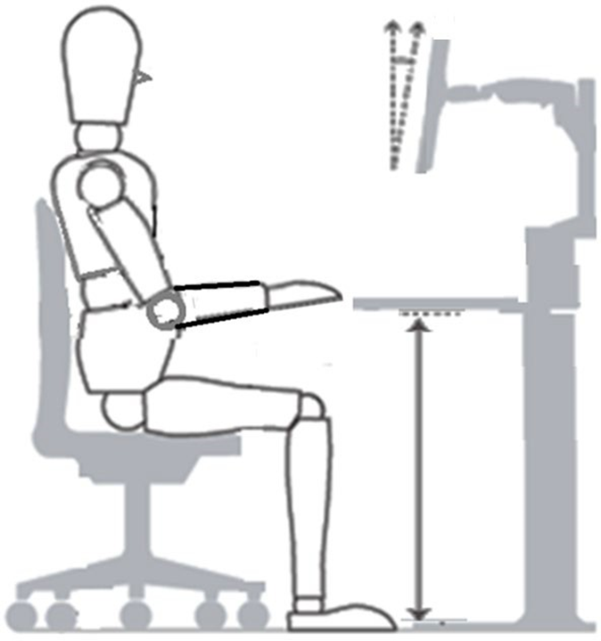
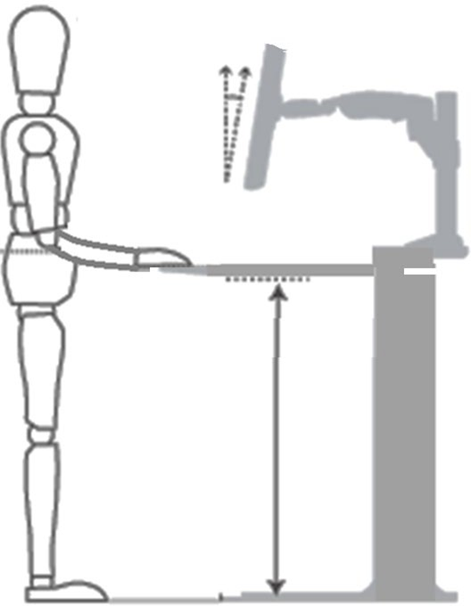
“Sitting at work is the new smoking”
True or Not True?

Slide 16
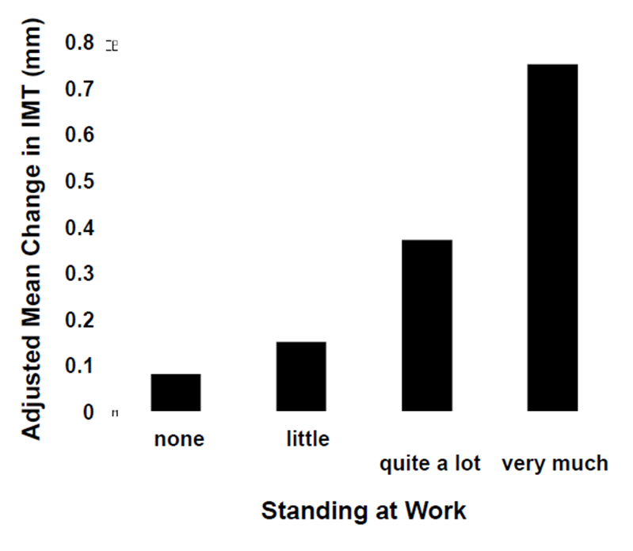
Standing at work is similar to smoking
Increases low back pain
Increase risk of CVD
Standing thickens blood vessel walls
  4-year Change of Carotid Intima Media Thickness (IMT), adjusted for Age, Technical, Physical and Psychosocial Job Factors, Income, Biological and Behavioral Factors: Men with IHD – smoking is an independent, yet has similar effect

Slide 17
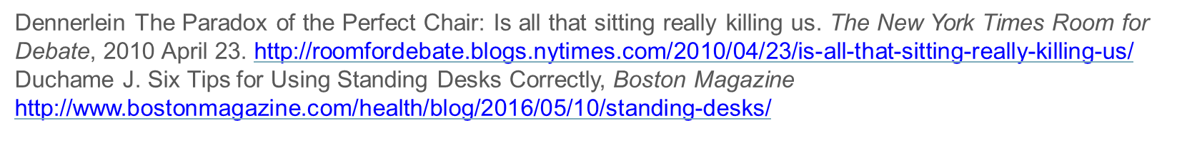
“Sitting at work is the new smoking”
True and Not True
Don’t stand all the time.
Despite the scary sitting research, standing 24/7 isn’t a great solution, either.
“Everybody says sitting is the new smoking. You have to remember standing is the old smoking”
That’s because sitting strains the arms, shoulders, and neck, but standing too much can lead to back pain.
Your best bet, is to rotate between the two positions.
“By mixing it up, you can change your posture”

Slide 18
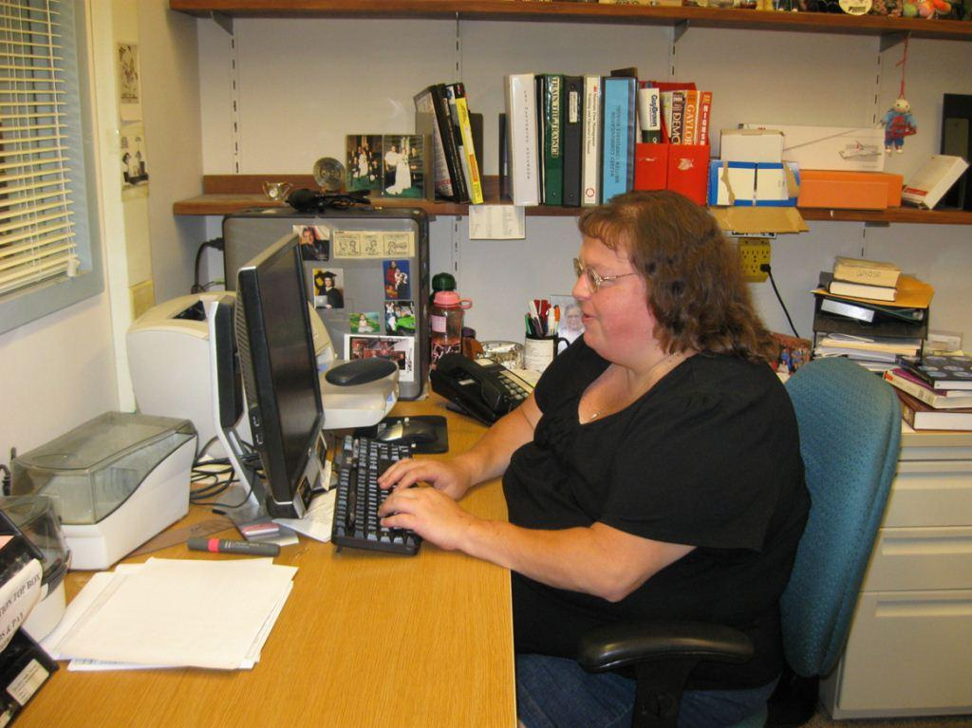

Slide 19
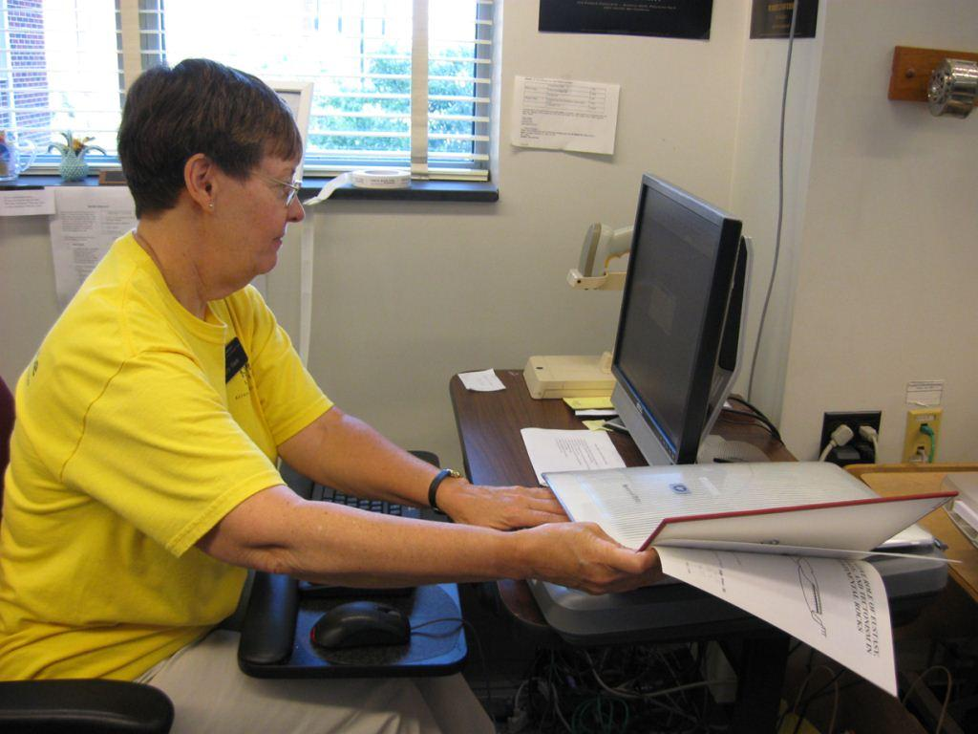

Slide 20
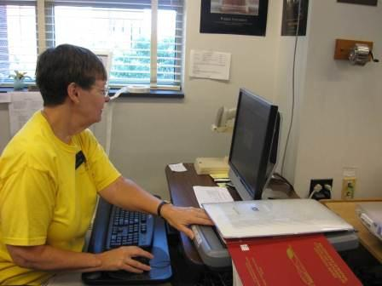

Slide 21
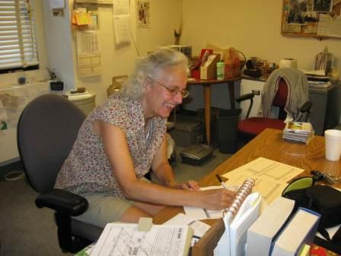

Slide 22
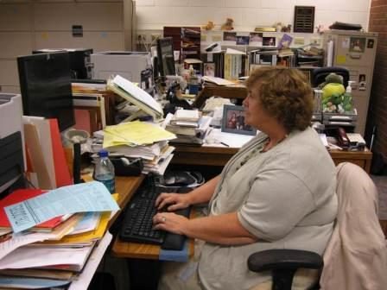

Slide 23
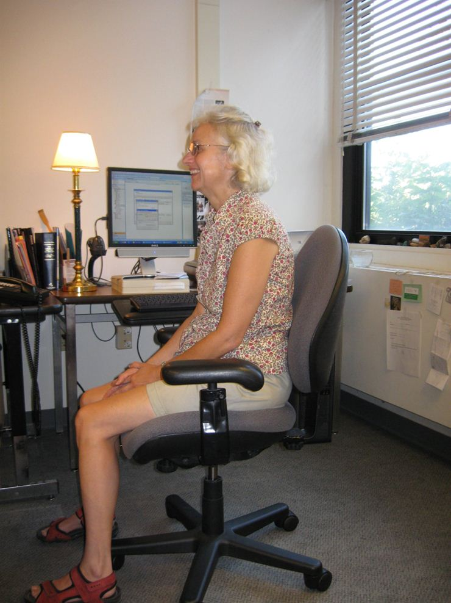

Slide 24
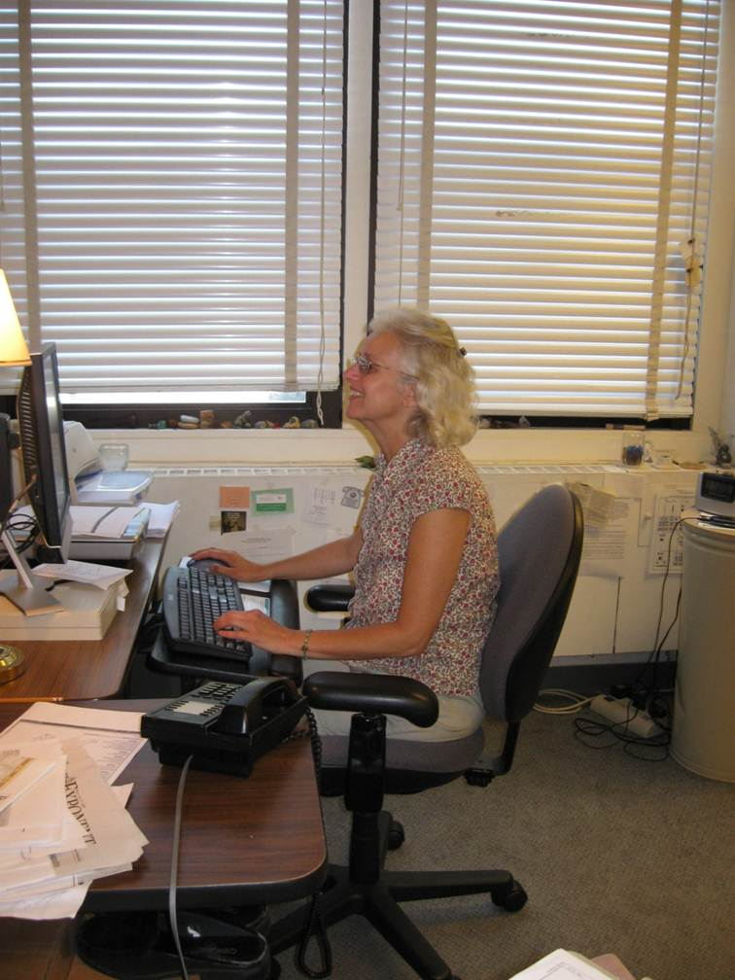

Slide 25
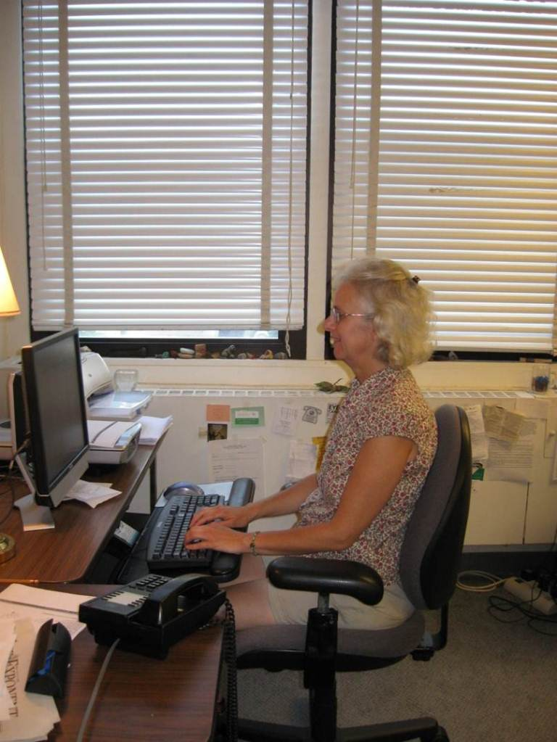

Slide 26
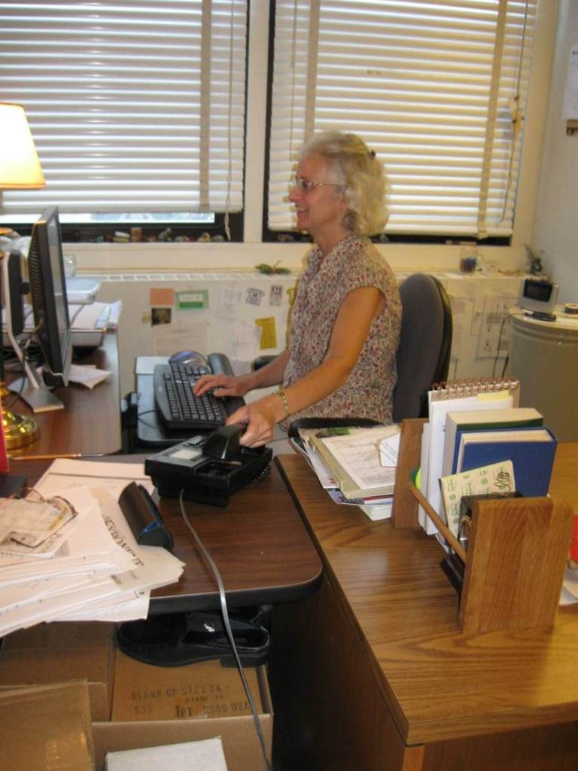

Slide 27
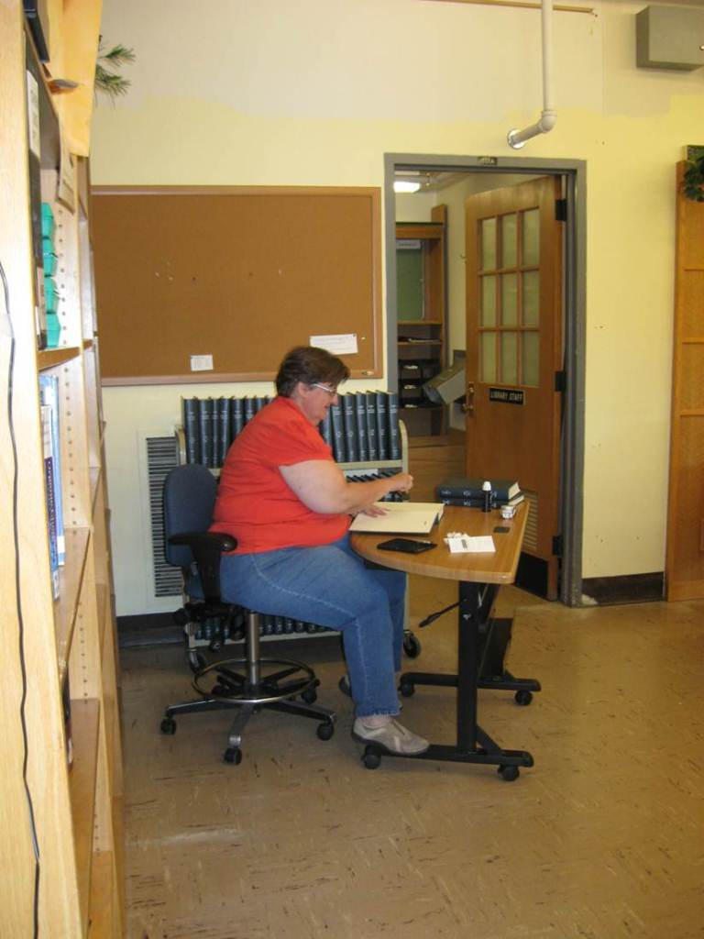

Slide 28
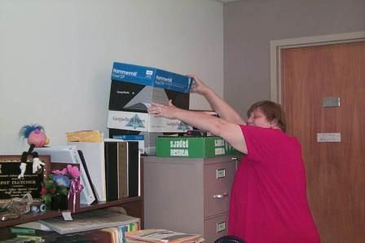

Slide 29
Micro Breaks
Whether your work is manual labor or at a desk
Take a micro break every 20-30 minutes
These only need to be a few seconds long, stretch, change body positions and return to the task.
Have you ever been working and found yourself surfing random news sites? That’s because your brain needs a break, rather than taking a “fake break” take a real break.

Slide 30
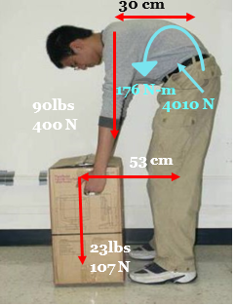
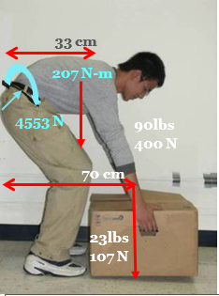
Lift from the knees
Is this always true?
Stoop or Squat
90lbs
400 N
90lbs
400 N
70 cm
53 cm
23lbs
107 N
23lbs
107 N
Compression
= 176/0.05 + 507*cos(20)
= 4010 N
Compression
= 207/0.05 + 507*cos(35)
= 4553 N

Slide 31
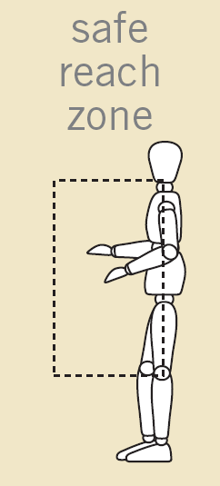
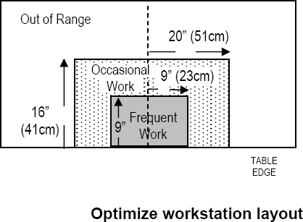
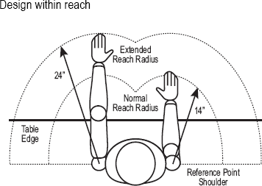
Safe work zone

Slide 32
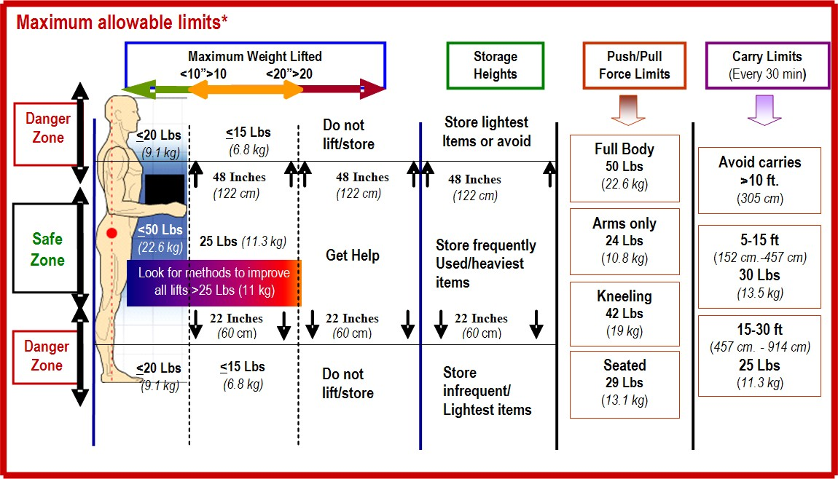
Manual Material Handling Guidelines
© Meg Honan
*High Frequency manual materials handling activities have lower maximal allowable limits

Slide 33
Total Worker Health
…policies, programs, and practices that integrate protection from work-related safety and health hazards with promotion of injury and illness prevention efforts to advance worker well-being.
www.cdc.gov/niosh/twh

